Slide 1
Web Engineering
Instructor: Faheem Shaukat
Meeting Hours
Wednesday and Thursday
12PM to 02PM

Slide 2
My Research Interest Shift
Web Development
Networking
AI/Machine Leaning

Slide 3
Weightage
Marks Distribution:
15% Lab (Lab Tasks/Participation + Lab Quiz + Lab Assignment)
10+10% Mini Projects + Main Projects
10% Quizs
5% Assignments
35% Final (Written + Practical)
25% Midterm (Written + Practice)
No Attendance issue but class participation matter.

Slide 4
Some Terms
WEB
HTML
HTTP
Internet
Intranet
URL

Slide 5
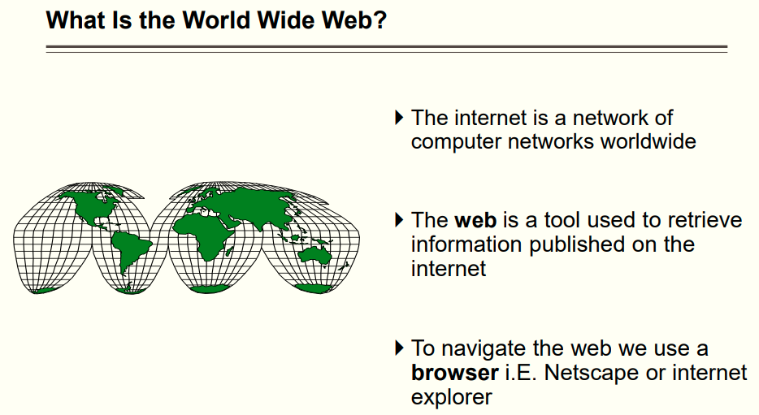

Slide 6
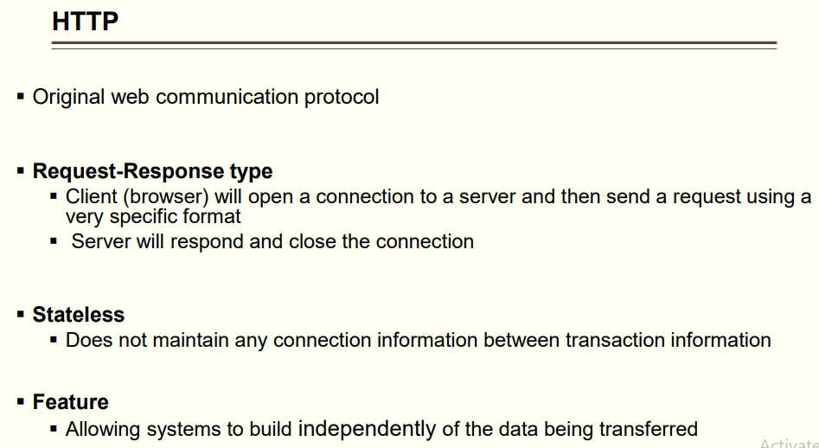

Slide 7
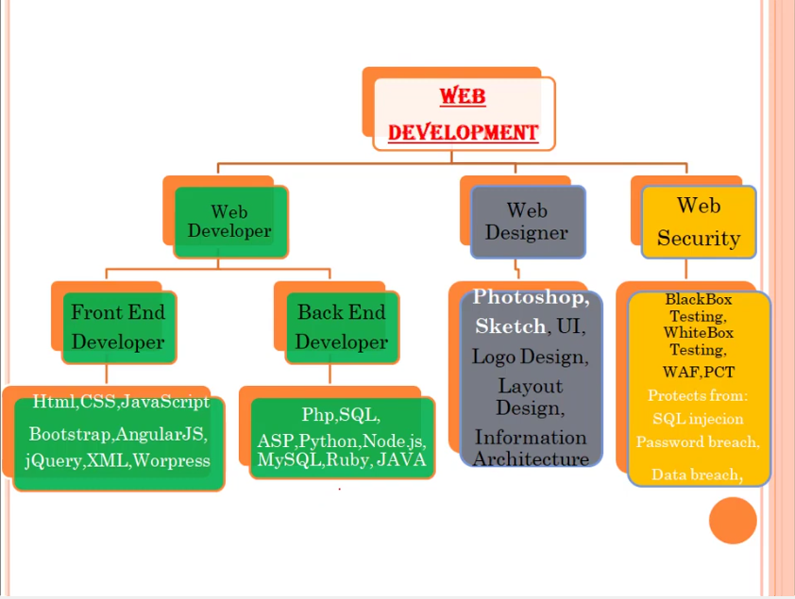

Slide 8
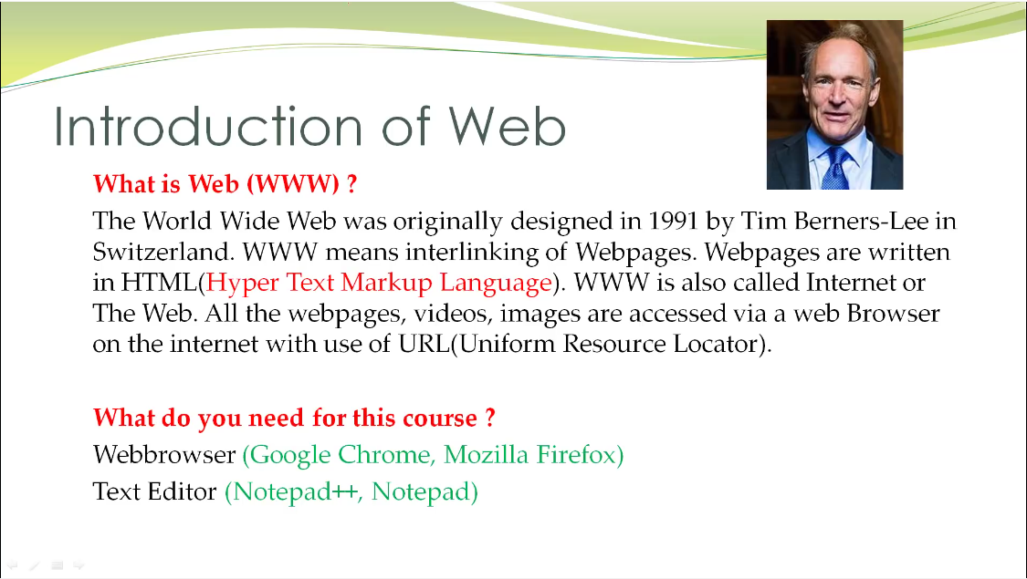

Slide 9
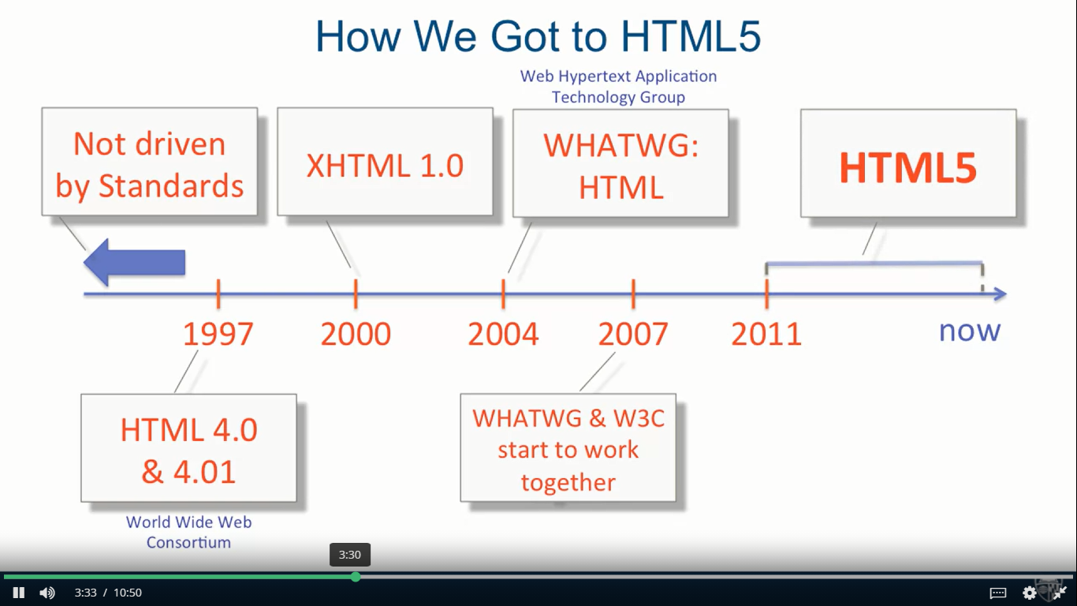

Slide 10
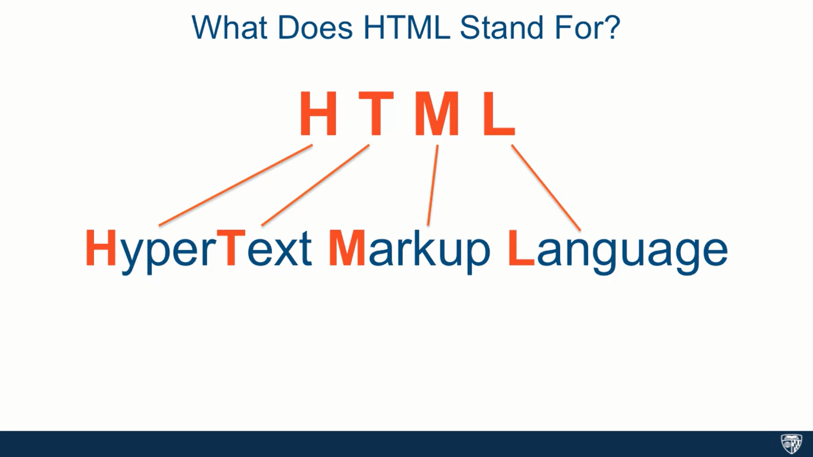

Slide 11
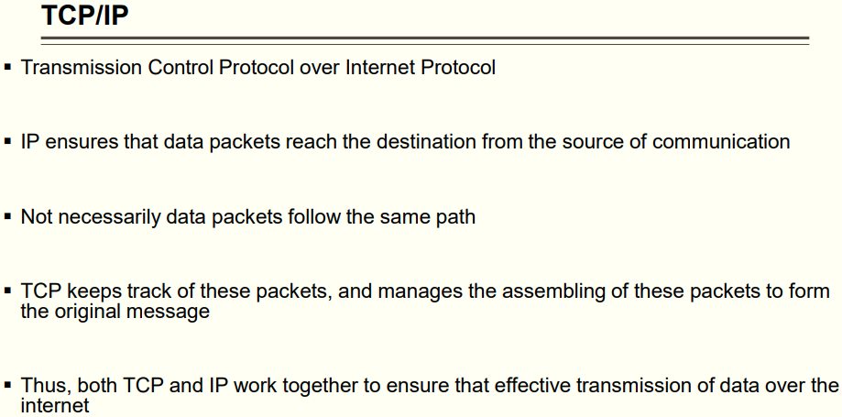

Slide 12
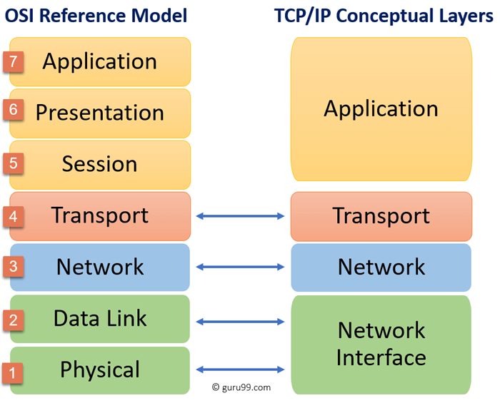

Slide 13
Today Task
Take One Page
Write your Name, ID and CGPA?
What is your expectation from this course?
Do you want any topic to Add or Remove?
Which website do you like in recent days, Name it and define why? Like due to interface user friendly or etc
And what type of website do you want or do you have wish/dream to make?
What do you think how website work?
Is Website is equal to WWW or URL or SERVER or internet or What?

